Slide 1
CS601PC:MACHINE LEARNING

Slide 2
CHAPTER 1
INTRODUCTION
CONTENTS:
WELL-POSED LEARNING PROBLEMS
DESIGNING A LEARNING SYSTEM
PERSPECTIVES AND ISSUES IN MACHINE LEARNING

Slide 3
Definition of Learning
A computer program is said to learn from experience E
with respect to some class of tasks T
and performance measure P,
if its performance at tasks in T,
as measured by P,
improves with experience E.

Slide 4
Definition Continued
Choice of P very important!! - Expert system or human comprehension? - Datamining!!
Broad enough to include most tasks that we would call “learning tasks” but also programs that improve from experience in quite straightforward ways (rote learning or caching)!
A database system that allows users to update data entries - it improves its performance at answering database queries, based on the experience gained from databases updates (same issue as what is intelligence)

Slide 5
Learning to Play Checkers
T : Play checkers
P : Percent of games won in world tournament
What experience?
What exactly should be learned?
How shall it be represented?
What speci c algorithm to learn it?

Slide 6
Example Learning Problems
Handwriting Recognition:
  T: recognising and classifying handwritten words with images
  P: percent of words correctly classified
  E: a database of handwritten words with given classifications
Robot driving:
  T: driving on public four lane highways using vision sensors
  P: average distance traveled before an error (as judged by human overseer)
  E: a sequence of images and steering commands recorded while observing a human driver

Slide 7
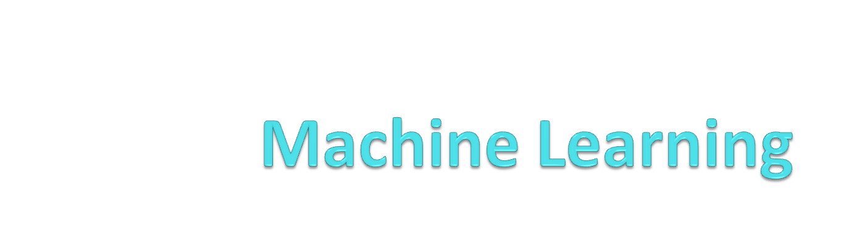
CSE - KMIT - AUTONOMOUS

Slide 8
Machine Learning
Machine learning is an application of artificial intelligence (AI) that provides systems the ability to automatically learn and improves from experience without being explicitly programmed.
Machine learning focuses on the development of computer programs that can access data and use it learn for themselves.
CSE - KMIT- AUTONOMOUS

Slide 9
Types of Learning
Supervised Learning
i) Regression
ii) Classification
Unsupervised Learning
i) Clustering
ii) Association
Reinforcement Learning
i) Markov Decision Process
ii) Q-Learning
CSE - KMIT - AUTONOMOUS

Slide 10
WELL-POSED LEARNING PROBLEMS
A computer program is said to learn from experience E with respect to some of tasks T and performance measure P, if its performance at tasks in T, as measured by P, improves with experience E.
CSE - KMIT- AUTONOMOUS

Slide 11
Checkers Learning Problem
Task T: Playing Checkers
Performance measure P: Percent of games won against opponents
Training experience E : Playing practice games against itself
CSE - KMIT- AUTONOMOUS

Slide 12
Handwriting Recognition Learning Problem
Task T : Recognizing and classifying handwritten words within images
Performance measure P : Percent of words correctly classified
Training Experience E : A database of handwritten words with given classifications
CSE - KMIT - AUTONOMOUS

Slide 13
Robot Driving Learning Problem
Task T: Driving on public four-lane highways using vision sensors
Performance measure P: Average distance traveled before an error
Training experience E : A sequence of images and setting commands recorded
CSE - KMIT - AUTONOMOUS

Slide 14
Applications of Machine Learning
Financial Services
Marketing and Sales
Healthcare
Transportation
Oil and Gas
CSE - KMIT - AUTONOMOUS

Slide 15
DESIGNING A LEARNING SYSTEM
Choosing the training experience
Direct or indirect feedback
Degree to which learner controls the sequence of training examples
How well it represents the distribution of examples over which the final system performance P must me measured
CSE - KMIT- AUTONOMOUS

Slide 16
DESIGNING A LEARNING SYSTEM
Choosing the Target Function
What type of knowledge will be learned and how this will be used by the performance program.
ChooseMove : B->M
B – Set of legal board states
M – Best move
Alternative Target Function: V : B -> R
R – Real value
CSE - KMIT - AUTONOMOUS

Slide 17
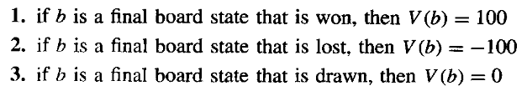


DESIGNING A LEARNING SYSTEM
If b is arbitrary board state in B then V(b) is
Learning algorithms to acquire only some approximation to the target function so target function is often called function approximation .
CSE - KMIT- AUTONOMOUS

Slide 18
DESIGNING A LEARNING SYSTEM
Choosing a representation for the target function
x1: the number of the black pieces on the board
x2: the number of the red pieces on the board
x3: the number of the black major on the board
x4: the number of the red major on the board
x5: the number of black pieces threatened by red
x6: the number of red pieces threatened by black
w0 to w6 are numerical coefficients (weights)
CSE - KMIT- AUTONOMOUS

Slide 19
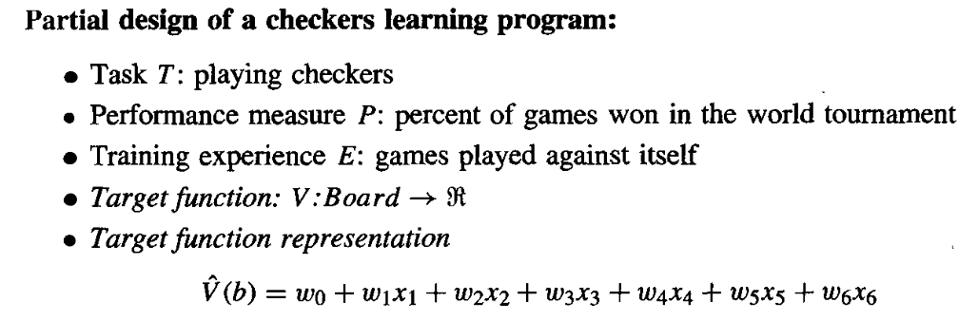
CSE - KMIT - AUTONOMOUS

Slide 20

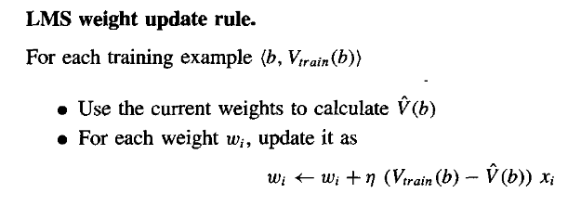
DESIGNING A LEARNING SYSTEM
Choosing a Function Approximation Algorithm
Estimating Training Values
Adjusting the weights
CSE - KMIT- AUTONOMOUS

Slide 21


= 0 -> No need to change weights
>0 -> Increase weight values
< 0 -> Decrease weight values
CSE - KMIT - AUTONOMOUS

Slide 22
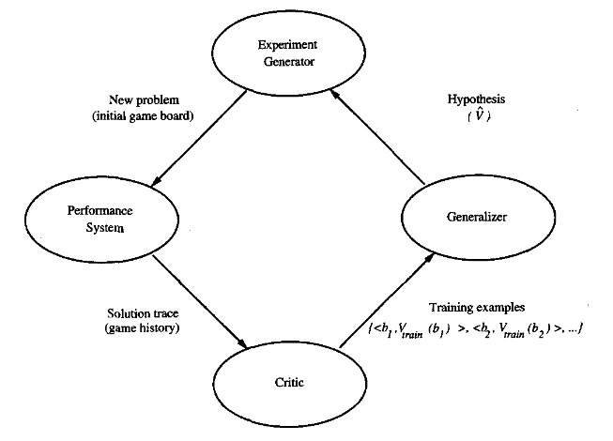
DESIGNING A LEARNING SYSTEM
Final Design
CSE - KMIT - AUTONOMOUS

Slide 23
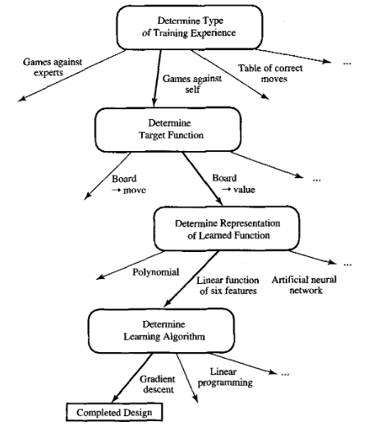
CSE - KMIT - AUTONOMOUS

Slide 24
Issues in Machine Learning
Which algorithms perform best for which types of problems and representations?
How much training data is sufficient?
When and how can prior knowledge held by the learner guide the process of generalizing from examples?
What is the best strategy for choosing a useful next training experience, and how does the choice of this strategy alter the complexity of the learning problem?
What is the best way to reduce the learning task to one or more function approximation problems?
How can the learner automatically alter its representation to improve its ability to represent and learn the target function?
CSE – KMIT- AUTONOMOUS

Slide 25
Designing a Learning System
T: checkers (draughts)
P: percent of games won in world tournament
What experience?
What exactly should be learned?
How shall it be represented?
What specific algorithm to learn it?

Slide 26
Type of Training Experience
Direct or indirect?
Teacher or not?
A problem: is training experience representative of performance goal?

Slide 27
Direct versus Indirect Learning
Individual checkers board states and correct move for each
Move sequences and final outcomes of various games played
Credit assignment problem - the degree to which each move in the sequence deserves credit or blame for the final outcome - game can be lost even when early moves are optimal, if these are followed later by poor moves or vice versa

Slide 28
Teacher or not?
Degree to which learner controls the sequence of training examples
  Teacher selects informative board states & provides the correct moves
  For each proposed board state the learner finds particularly confusing it asks the teacher for correct move
  Learner may have complete control as it does when it learns by playing itself with no teacher - learner may choose between experimenting with novel board states or honing its skill by playing minor variations of promising lines of play

Slide 29
Choose Training Experience
How well training experience represents the distribution of examples over which the final system performance P must be measured
P is percent of games in the world tournament, obvious danger when E consists of only games played against itself (probably can’t get world champion to teach computer!)
Most current theories of machine learning assume that the distribution of training examples is identical to the distribution of test examples
It is IMPORTANT to keep in mind that this assumption must often by violated in practice.
E: play games against itself (advantage of getting a lot of data this way)

Slide 30
Choose a Target Function
ChooseMove: B -> M where B is any legal board state and M is a legal move (hopefully the “best” legal move)
Alternatively, function V: B -> ℜ which maps from B to some real value where higher scores are assigned to better board states
Now use the legal moves to generate every subsequent board state and use V to choose the best one and therefore the best legal move

Slide 31
Choose a Target Function II
  V(b) = 100, if b is a final board state that is won
  V(b) = -100, if b is a final board state that is lost
  V(b) = 0, if b is a final board state that is a draw
  V(b) = V(b´), if b is not a final state where b´ is the best final board state starting from b assuming both players play optimally
Not computable!! - non-operational definition (changes over time!!! - Deep Blue)
Need Operational V - What are Realistic Time Bounds??
May be difficult to learn an operational form of V perfectly - Function Approximation V^{hat}

Slide 32
Choose Representation for Target Function
Use a large table with an entry specifying a value for each distinct board state
Collection of rules that match against features of the board state
Quadratic polynomial function of predefined board features
Artificial neural network
NOTICE - choice of representation is closely tied to algorithm choice!!

Slide 33
Expressability Tradeoff
Very expressive representations allow close approximations to the ideal target function V, but the more expressive the representation the more training data the program will require in order to choose among the alternative hypothesis
Also depending on the purpose, a more expressive representation might make it more or less easy for people to understand!

Slide 34
Design So Far
T: Checkers
P: percent of games won in world tournament
E: games played against self
V: Board -> ℜ
Target Function Representation:
V´(b) = w₀ + w₁x₁ + w₂x₂ + w₃x₃ + w₄x₄ + w₅x₅ + w₆x₆

Slide 35
Choose Function Approximation Algorithm
First need Set of training examples
  <b,V_{train}(b)>
  <(x₁=3,x₂=0,x₃=1,x₄=0,x₅=0,x₆=0),+100> because x₂=0
V_{train}(b) <- V´(successor(b))
  Good if V´ tends to be more accurate for board positions closer to game’s end

Slide 36
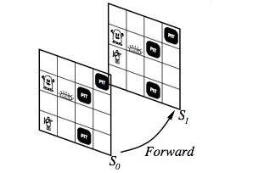
Successor

Slide 37
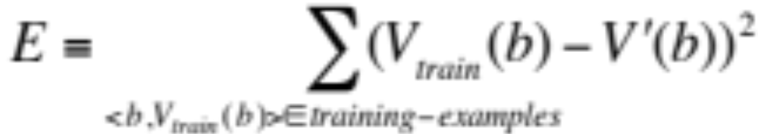
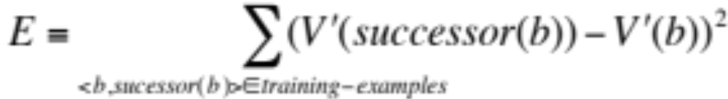
Choose Learning Algorithm
Learning Algorithm for choosing weights w_{i} to best fit the set of training examples
{<b,V_{train}(b)>} ≡ {<b,V´(Successor(b))>}
Best fit could be defined as minimizes the squared error E

Slide 38
Choose learning Algorithm II
We seek the weights that minimise E for the observed training examples
We need an algorithm that incrementally refines the weights as new training examples become available & is robust to errors in estimated training values
One such algorithm is LMS (basis of Neural Network algorithms)

Slide 39
Least Mean Squares
LMS adjusts the weights a small amount in the direction that reduces the error on this training example
Stochastic gradient-descent search through the space of possible hypothesis to minimize the squared error
Why stochastic ???

Slide 40
LMS Algorithm
LMS: For each <b,V_{train}(b)> use current weights to calculate V´(b). For each weight
Where η is a small constant .01 that moderates the size of the weight update

Slide 41
LMS Intuition
To get an intuitive understanding notice that
when the error is 0 no weights are changed,
when it is positive then each weight is increased in proportion to the value of its corresponding feature
Surprisingly, in certain settings this simple method can be proven to converge to the least squared approximation to V_{train}.
  In how many training instances?
  How understandable is the result? (Datamining)

Slide 42
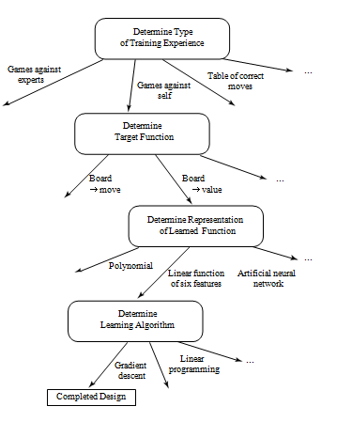
Design Choices

